Slide 1
Analysis of Special Purpose Acquisition Companies
Ben Bresalier & Kim Harrison, Krista Labovich

Slide 2



Meet the Team
Ben Bresalier
University of Colorado | B.S. in Political Science ‘21
Kimberly Harrison
University of Colorado |B.S. Finance ‘19
Krista Labovich
University of Colorado |B.S. in Digital Marketing, Management ‘19
Notes:
How many years does a SPAC have to complete an acquisition or merger? 2
What is another name for a SPAC? Blank Check Company
In what decade did SPACs first appear? 80s

Slide 3
What are SPACs?
Notes:
Also known as blank check companies, SPACs are publicly traded companies created for the purpose of acquiring or merging with an existing company. At the time of their IPOs, SPACs have no n existing business operations - they are a shell company at the time of IPO.
Special Purpose Acquisition companies (SPAC) have recently taken the spotlight in the financial world - in only three months, they outperformed the previous year’s issuance record by $4 billion. In 2020, SPACs accounted for more than 50% of new publicly listed US companies
What makes investing in a SPAC attractive? Speed. A company can go public through the SPAC route in a few months, while the IPO process can take more than a year. Additionally, merging with/being acquired by a SPAC that is sponsored by financial giants is a great way to boost your market visibility overnight.

Slide 4
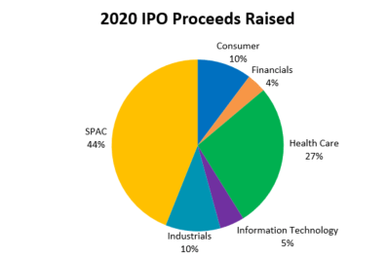
Notes:
As you can see, SPACs are dominating the IPO market share - jumping from only 14% in 2007 to nearly 50% in 2020

Slide 5

The Business Opportunity
Notes:
There is clearly a great deal of opportunity in this market. Our team attempted to uncover the similarities and differences between SPACs and traditional IPO securities regarding the factors that drive the stock price. By examining both securities, we were able to investigate influential features driving price changes. Ultimately, this analysis can be used to make more informed decisions for when to enter and exit the market for both types of securities.

Slide 6
Model Creation
Compared 5 pairs of securities with similar revenue exposures. One security IPO’d via a traditional IPO while the other was acquired by a SPAC.
Observed the securities reactions to 10 variables with linear regression, logistic regression and decision trees.

Slide 7
SPACs | Non-SPAC Comparison
Clarivate PLC | Intertek
Vertiv Holdings | Bloom Energy
Willscot Corporation | Herc Holdings
Virgin Galactic Holdings | Spirit AeroSystems
Nikola Corporation | Prospect Capital Group

Slide 8
Model Creation
Compared 5 pairs of securities with similar revenue exposures. One security IPO’d via a traditional IPO while the other was acquired by a SPAC.
Observed the securities reactions to 10 variables with linear regression, logistic regression and decision trees.

Slide 9
Findings: Linear and Logistic Regression
Similar reactions to variable for both SPACs and Non-SPACS
Most notably, Relative Strength Index had a significant, positive correlation on price change
One day lagged news publication count had a significant effect on percent price change for 3 securities: Willscot Corp, Intertek, and Herc Holdings

Slide 10
Findings: Decision Trees
Similar reactions to variable for both SPACs and Non-SPACS
9 out of 10 trees reinforced that RSI is the best predictor of an upward or downward movement in price

Slide 11
Conclusions
There is no key significance between SPACs and traditional IPOs for the variables observed
The Relative Strength Index is a key indicator of price change for all securities and should be evaluated further

Slide 12

What is RSI (Relative Strength Index)?
A technical indicator based off of a calculation of 14 day gains and losses
Oscillates on a scale between 0 and 100.
A reading above 70 warns of an overbought condition and is likely to encounter a downward correction.
Readings below 30 are considered an oversold condition and warns of an imminent upward correction.

Slide 13
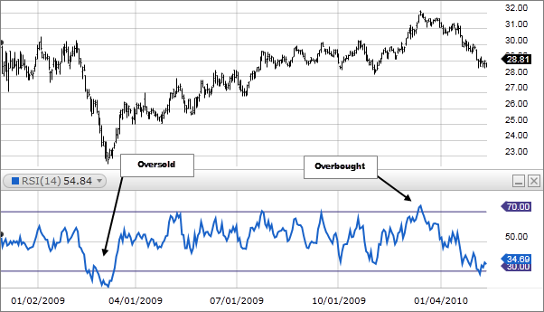

Slide 14
Evaluating RSI as a Significant Indicator
Created logistic regression model using RSI as the independent variable.
Used the probability output to predict if the security’s price would go up or down based off of 50% threshold.
Theoretically invested $100 per security in the test set based off of our recommendations provided by the output.
Buy when the price of the security is predicted to go up and reap benefits or consequences of percent change in price.
Sell when the price of the security is predicted to go down and forfeit benefits or consequences of percent change in price.
Compared this to a buy and hold method which looks at the cumulative percent change in price over the time frame of the test set

Slide 15


Slide 16
Results
Security | Percent Return of Our Model | Percent Return of Buy/Hold | Difference of our Model to Buy/Hold
Intertek | +22.3% | -2.6% | +24.9%
Clarivate PLC | +24.8% | +0.9% | +23.9%
Vertiv Holdings | +22.0% | -4.6% | +26.6%
Bloom Energy | +93.1% | +20.5% | +72.6%
Wilscot Corp | +51.7% | +40.1% | +11.6%
Herc Holdings | +90.9% | +67% | +23.9%
Virgin Galactic Holdings | -24.1% | -62.8% | +38.7%
Spirit Aerosystems | +36.9% | -15.2% | +52.1%
Nikola Corporation | +42.4% | -30.50% | +72.9%
Prospect Capital Group | +13.8% | +7.3% | +21.1%

Slide 17
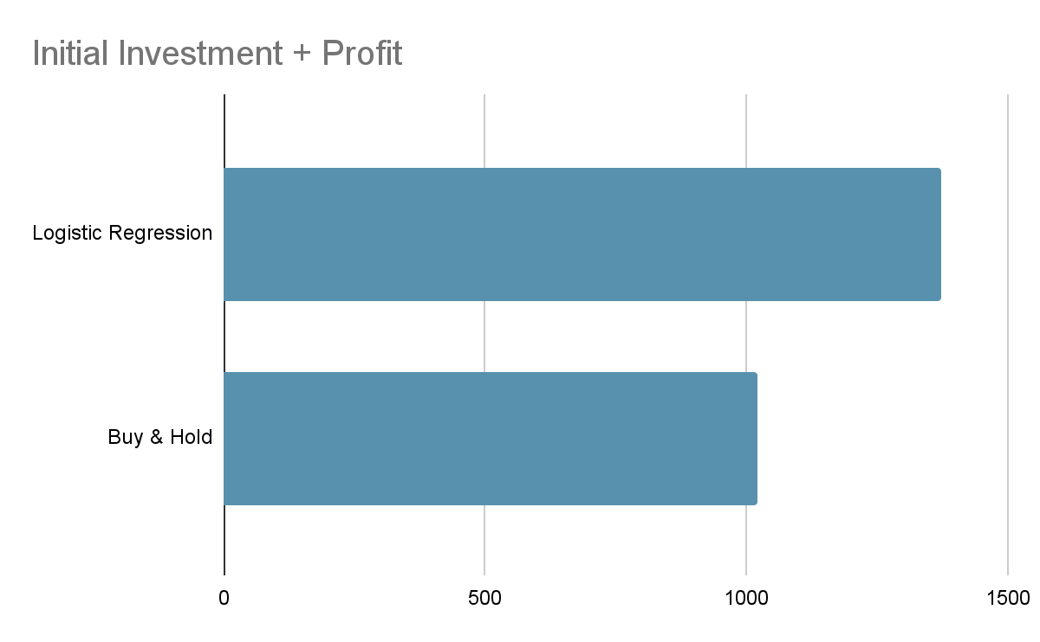
Results

Slide 18
Deployment
Treat SPACs and traditional IPO securities similarly
01
Run further analysis on RSI across a broader group of securities to see if the relationship can be generalized and applied to a universe of securities
02
Use the logistic regression model as a tool to validate an investor’s choice to trade
03

Slide 19
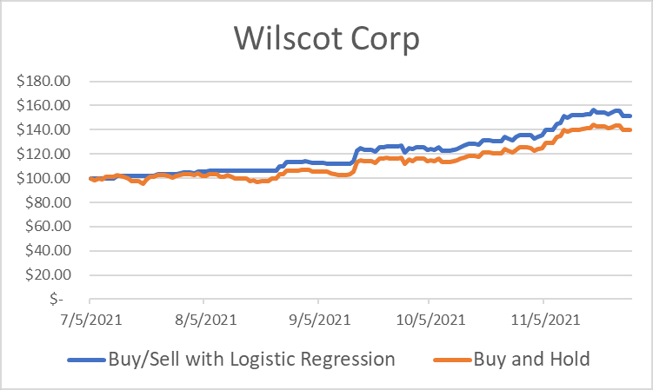
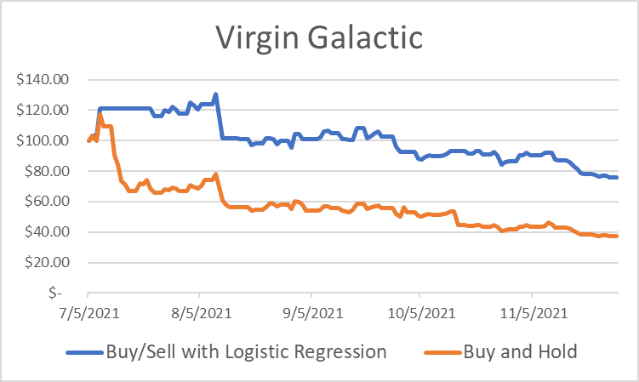
Concerns
Absence of fees
Prediction of upward trending versus downward trending securities

Slide 20
Concerns
Training the model to understand the interaction of the change in RSI and the level it is at
Attempted to model this with spotlight tests on levels of RSI and the interaction if the RSI was above or below 70 with percent change

Slide 21
Conclusion
RSI is a significant predictor of the securities tested and using it in a model beats a buy-hold method on average by 36%
SPACs and Non-SPACs do not react differently to the variables we observed and should be treated uniformly

Slide 22
Questions?

Slide 23
Thank you!

